Slide 1


Low Vision Rehabilitation on a Shoestring Budget: High Impact Strategies when Resources are Limited
Beth Barstow PhD, OTR/L, SCLV, OTCAVR, FAOTA
Program Director and Professor
Occupational Therapy
The University of Alabama

Slide 2
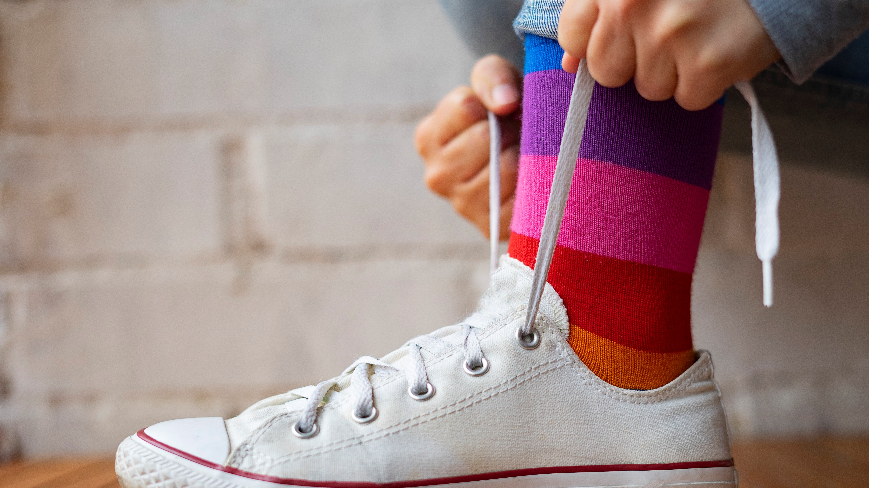
Session Objectives
Identify low-cost interventions that improve occupational performance and interdisciplinary practice.
Collaboratively solve participation problems for those with vision loss using limited resources.

Slide 3

Common Barriers to Participation

Slide 4
Lighting
Strong evidence that lighting is one of the most important environment modifications for people with vision loss
  Improves reading performance
  Better visual acuity and contrast sensitivity function
  Enhanced safety and mobility
  Increased occupational performance
  Reduced visual fatigue and improved comfort
  Needs vary- one light does not fit all

Slide 5
Lighting
Green, M., Barstow, B., & Vogtle, L. (2018). Lighting as a compensatory strategy for acquired visual deficits after stroke: Two case reports. American Journal of Occupational Therapy.
Stelmack et al. (LOVIT and LOVIT II) for environmental modification as part of multidisciplinary low vision rehabilitation.
Warren & Barstow (2011). Occupational Therapy Interventions for Adults with Low Vision.

Slide 6
Contrast
Evidence that enhancement of contrast improves occupational performance
  Improved reading performance
  Reduced falls and safer mobility
  Improved occupational Performance

Slide 7
Contrast
Stelmack JA et al. (2008). The Veterans Affairs Low Vision Intervention Trial (LOVIT). Archives of Ophthalmology.
Stelmack JA et al. (2017). LOVIT II. JAMA Ophthalmology.
Arditi A. (2005). Improving the Design of the Visual Environment for People with Low Vision.
Rubin GS. (2013). Measuring reading performance and visual disability in age-related macular degeneration.
Black AA et al. (2011). Studies relating contrast sensitivity to falls and mobility in older adults.

Slide 8
Glare
Evidence that glare reduction improves occupational performance
Decreases the visibility of objects by reducing contrast and washing out visual details
  Key component to successful reading and near tasks
  Improved occupational performance
  Improves work and productivity
  Improved edge detection with stairs- particularly in older adults

Slide 9
Glare
Warren, M., & Barstow, B. (2011). Occupational Therapy Interventions for Adults with Low Vision. (AOTA Press
Green, M., Barstow, B., & Vogtle, L. (2018). Lighting as a compensatory strategy for acquired visual deficits after stroke. American Journal of Occupational Therapy.
Stelmack et al. (LOVIT and LOVIT II), which support environmental modification as part of comprehensive low vision rehabilitation.

Slide 10
Clutter
Strong evidence that clutter negatively affects visual function, mobility, safety and occupational performance
  Part of environmental assessment and modification
  Effects visual attention and object identification
  Effects fatigue and anxiety

Slide 11
Clutter
Perkins School for the Blind. Adapting Environments for Individuals with Vision Loss. Environmental modifications including reducing visual clutter.
Perkins School for the Blind. CVI: Impact of Clutter. Detailed discussion of how clutter impairs visual attention, recognition, navigation, and increases fatigue and anxiety.
APH ConnectCenter. Orientation and Mobility: Navigating Your Environment with Confidence. Describes challenges associated with obstacles and navigation in vision loss.

Slide 12
Fatigue
Evidence that fatigue is a significant and often underrecognized consequence of vision loss
Symptoms such as eye strain, tired, headaches, reduced concentration, reduced endurance, frequent breaks, increased effort
Evidence supports environmental modification reduces fatigue
  Effect reading performance
  Reading for occupational performance
  Sustained near vision work

Slide 13
Fatigue
Schakel W. et al. (2019). The association between visual impairment and fatigue: A systematic review and meta-analysis of observational studies.
Schakel W. et al. (2019). Understanding fatigue in adults with visual impairment. PLoS ONE.

Slide 14
Psychosocial Adaptation
Strong and growing body of evidence
Vision loss is associated with anxiety, fear, stigma, depression, social isolation and changes in identity
1 of 4 adults with vision loss experience anxiety or depression
  Activity avoidance
  Reduced community mobility
  Decreased leisure participation
  Loss of employment
  Reduced confidence
  Lower rehab engagement

Slide 15
Psychosocial Adaptation
Almidani et al. (2024). Vision Impairment and Psychosocial Function in US Adults. JAMA Ophthalmology.
CDC (2024). About Vision Loss and Mental Health.
Schakel et al. (2019). Understanding fatigue in adults with visual impairment. (Useful for discussing psychosocial burden and adaptation.)
Prevent Blindness Mental Health Task Force (2023). Vision Loss and Mental Health: Key Takeaways from an Interprofessional Task Force.
Walia & Morya (2026). Psychiatric disorders linked to visual impairment: A review of mental health challenges and interventions across age groups

Slide 16

Many problems are Environmental Problems

Slide 17
Basic Intervention Strategies
Environmental modification
  Lighting
  Contrast
  Organization- reduced clutter
  Reduce glare
Compensatory strategies
  Task simplification
  Training in new habits and routines
  Sensory substitution
  Enlarge
Assistive Technology
Enhance use of remaining vision
Education
Referral

Slide 18

The $450.00 Rand challenge

Slide 19
Rules…
You have only $450.00 Rand
Access only to resources in your area
No specialized low vision equipment allowed
Think about all the intervention strategies
Based on your case, outline what you would do
Can use Smart Phone

Slide 20
Examples
Expensive Option | Shoestring Alternative
CCTV | Smartphone camera
Electronic reader | Built-in phone accessibility
Low Vision task light | Inexpensive clamp light
Custom Contrast tape | Colored electrical tape

Slide 21
Be ready to share
Our biggest barrier was…
Our best low-cost solution was…
Our most creative idea was….
Tell us your shoestring list and how much you spent

Slide 22
Case One
82-year-old female
Age-related Macular Degeneration
Complaints
  Cannot read medication labels
  Cannot see appliance dials/buttons- stove, microwave, washer, dryer
  Difficulty measuring ingredients- over or under fills
  Glare present off her kitchen counters- window adjacent

Slide 23
Case Two
69-year-old male
Glaucoma
Complaints
  Falling in garage
  Trouble seeing stairs
  Avoids church at night
  Difficulty hammering without hitting his thumb/hand

Slide 24
Case Three
58-year-old female
Diabetic Retinopathy
Complaints
  Cannot read financial statements
  Fear of losing her job as an administrative assistant
  Difficulty seeing text on her Smart phone
  Embarrassed by her vision loss

Slide 25

The best intervention is not always the most expensive one. It is the one that allows participation in meaningful occupations

