Slide 1


Integrating the Revised Self-Report Assessment of Functional Visual Performance (R-SRAFVP) Intervention Planning & Goal Setting
Beth Barstow PhD, OTR/L, SCLV,
OTCAVR, FAOTA
Program Director and Professor
Occupational Therapy
The University of Alabama

Slide 2
R-SRAFVP
Standardized low vision assessment
Purpose
  Designed to measure how vision impairment affects a person’s ability to perform vision dependent activities of daily living and instrumental activities of daily living
  Determine which areas of daily living are most affected by vision loss
  Assist with goal setting in vision rehabilitation
  Measure outcomes before and after intervention
  Determine the level of independence or dependence by percent
Originally developed in 1996, Velozo and revised in 2018

Slide 3

Population
Adults with low vision, particularly older adults

Slide 4
Structure
33 items organized into 9 components
Self-report Assessment
  Health Management and medication routines
  Feeing
  Clothing care
  Meal preparation
  Shopping
  Telephone use
  Leisure participation
  Reading and writing
  Community participation
  Functional mobility
Optional observational assessment of selected ADLs
  Read a food label
  Read a medication label
  Write signature on a regular line
  Address envelope
  Pour a glass of water Make change
  Set time

Slide 5
Scoring
5-point rating scale
  0-unable, dependent on others to perform the task
  1-great difficulty, requires assistance with 50-75% of the task, and/or cannot perform in a safe and efficient manner
  2-moderate difficulty, difficulty under optimal conditions, difficulty performing in a timely manner, and/or safety and efficiency questionable, and/or makes errors, and/or assistance required for 25-50% of the task
  3-minimal difficulty, some difficulty and/or can only perform under optimal conditions, may require assistance for 25% or less of the task
  4-independent, experiences no difficulty performing tasks safely, accurately or efficiently
Individuals rate the difficulty they experience performing vision-dependent tasks

Slide 6
Limitations
Self-report measure- responses may not always match actual observed performance
Many clinicians pair with:
  Functional observation
  MNREAD or other reading assessments
  Contrast sensitivity testing
  Visual field assessment
  Other occupational performance measures like the COPM

Slide 7
Scoring
Step 1: Calculate the Adjusted Total Possible Points
  Determine the possible number of points that the client can earn on the form. (Total number of ADL tasks that the client deems as applicable for daily living multiplied by the highest possible score for each item)
  N/A or not applicable items are omitted from the calculation
  Number of tasks the client completes X4= Adjusted total possible points
Example
  1 N/A out of 33= 32 items completed
  32 X 4= 128
  Adjusted total = 128

Slide 8
Scoring
Step 2: Calculate the Client’s Total Score
  Add up the rating points for each item the client completes to calculate the total number of points earned
Example
  Add the ratings for the 32 items answered = 79
  Client’s total score = 79

Slide 9
Scoring
Step 3: Calculate the SRAFVP Score
  Divide total score (step 2) by the adjusted total score (step 1)
  Provides a decimal score
Example
  79 ÷ 128 = .6171875
  To determine the level of independence
    Multiply the decimal SRAFVP score by 100 and round up to the nearest full percentage score to indicate the client’s level of independence in the assessed vision-dependent ADLs
    .6171875 X 100 (rounded up to nearest full percent) = 62
    SRAFVP Level of Independence Score = 62%
  To determine the level of dependence
    Subtract percent level of independence from 100
    100-62 = 38
    SRAFVP Level of Dependence Score = 38%

Slide 10
Let’s work though the case study example
See the case form, work in small groups, be ready to present the following
  Make a list of areas which require intervention?
  List your top three priority areas.
  Why did you choose these areas?
  Write a goal for one of the areas.
  If the client was reporting differently from the family, what could you do?
  Reflect on the usefulness of this tool in your clinical practice.

Slide 11
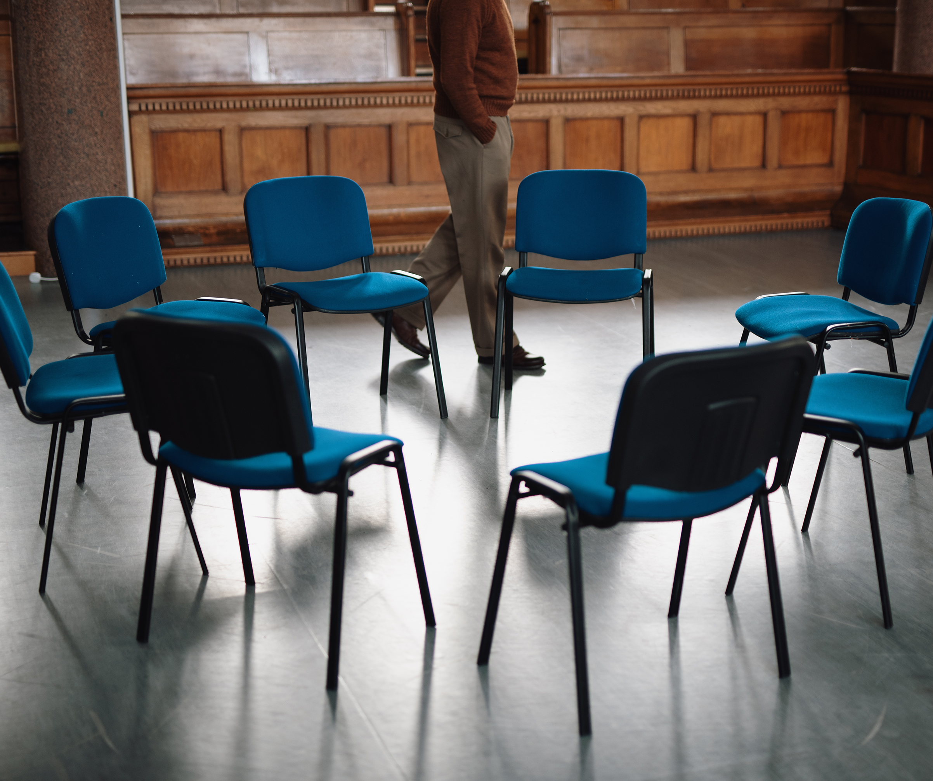
Group Discussion

